Slide 1
AMOS TEAM MEMBER

Slide 2
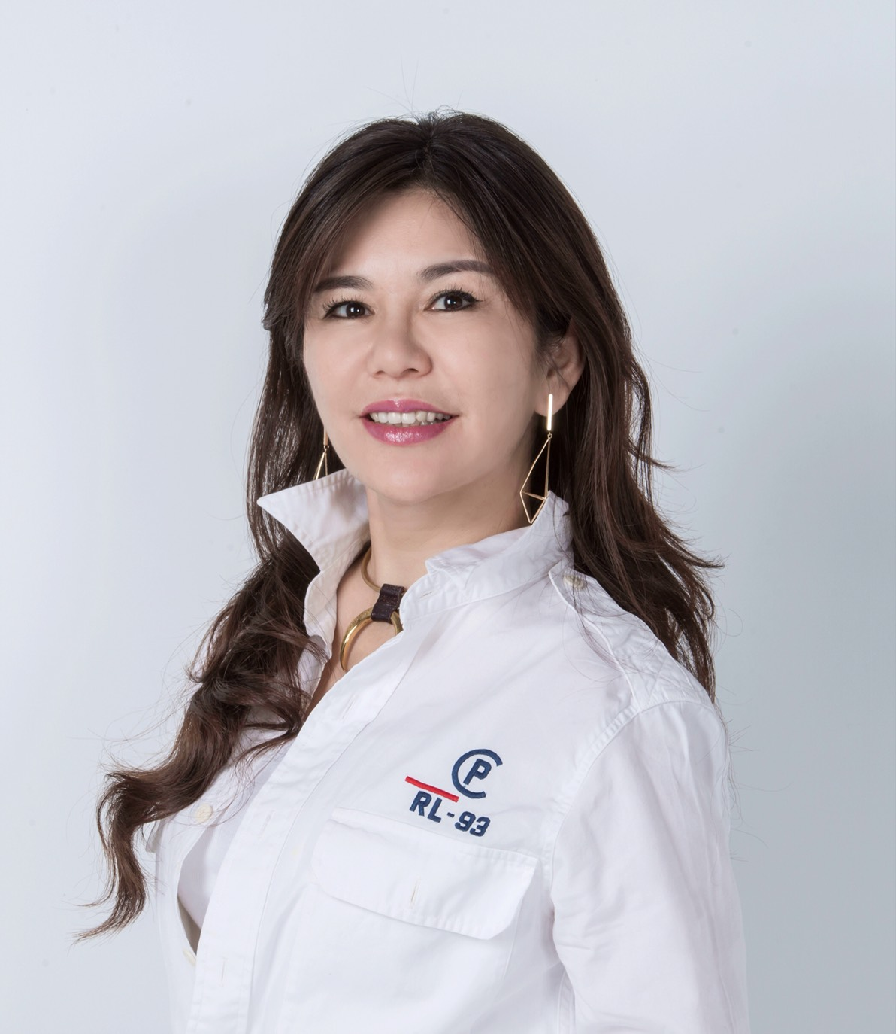
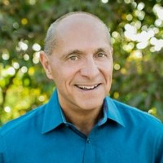
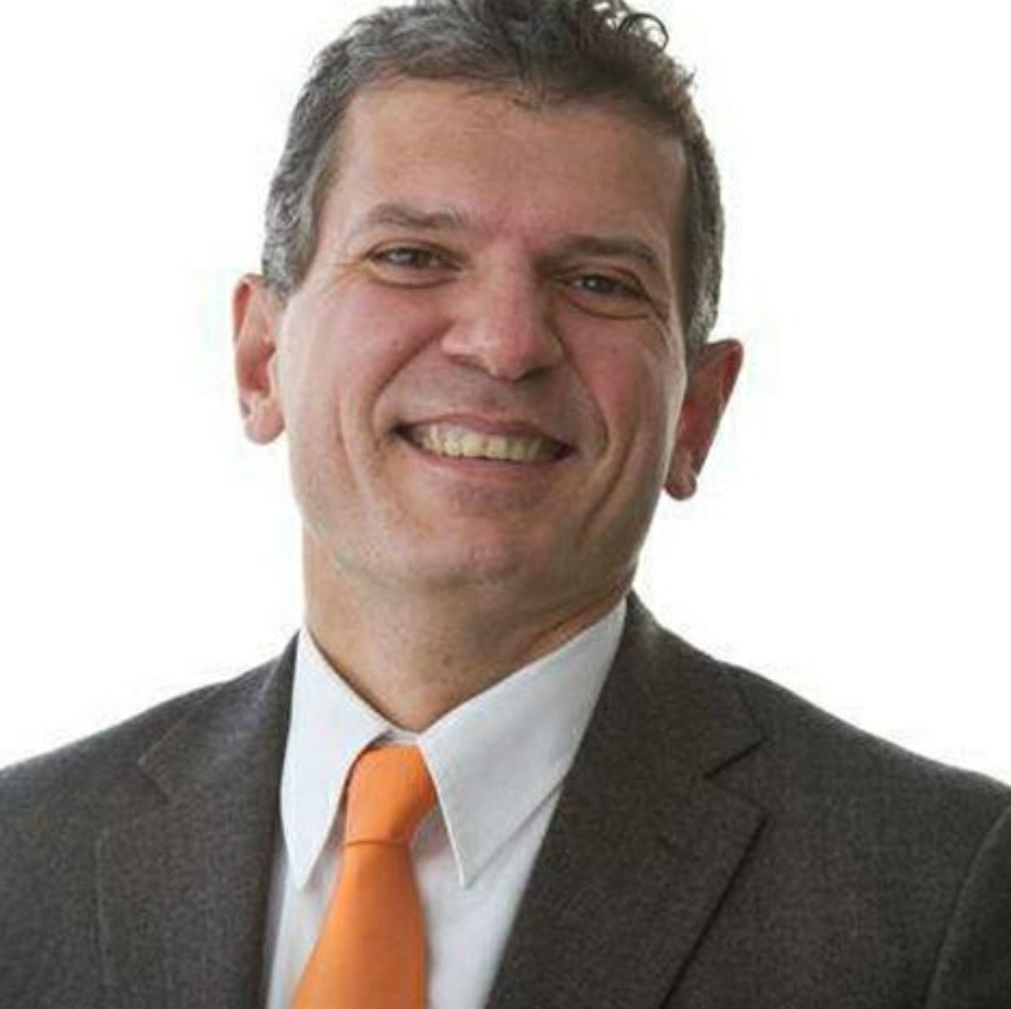
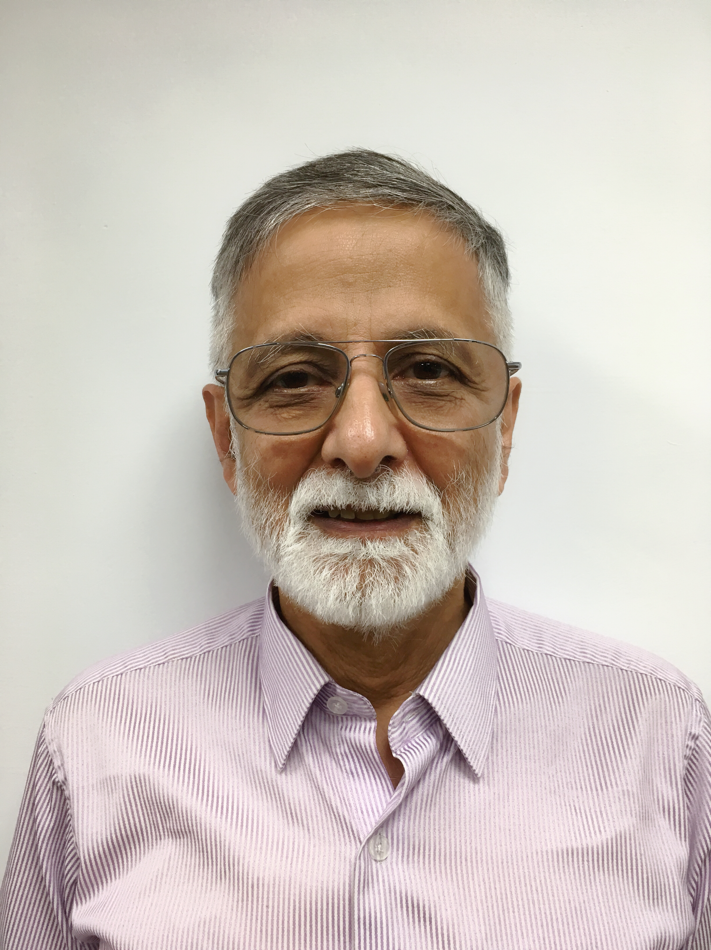
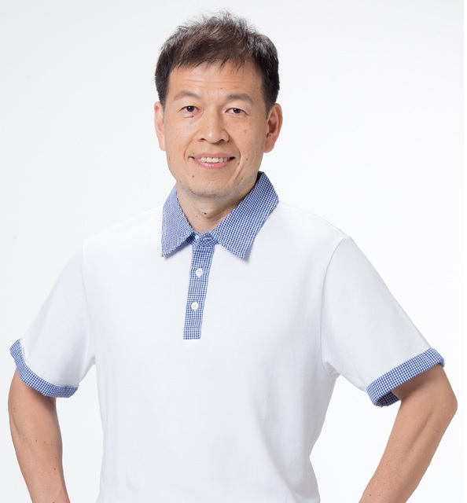
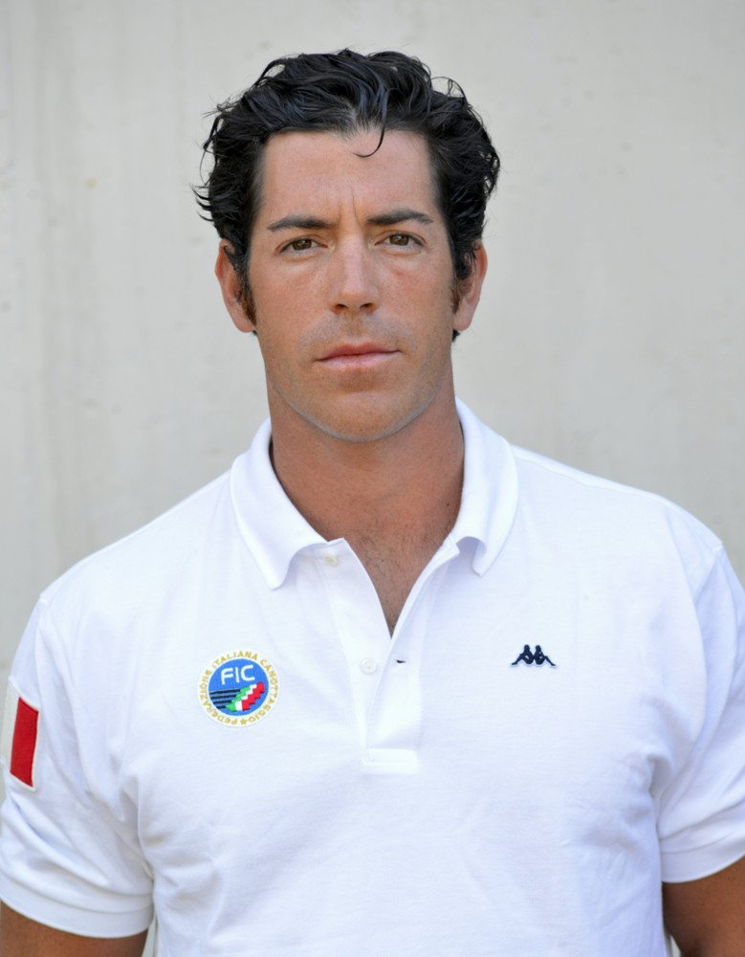
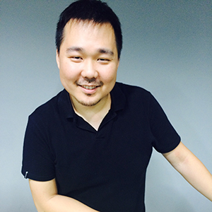
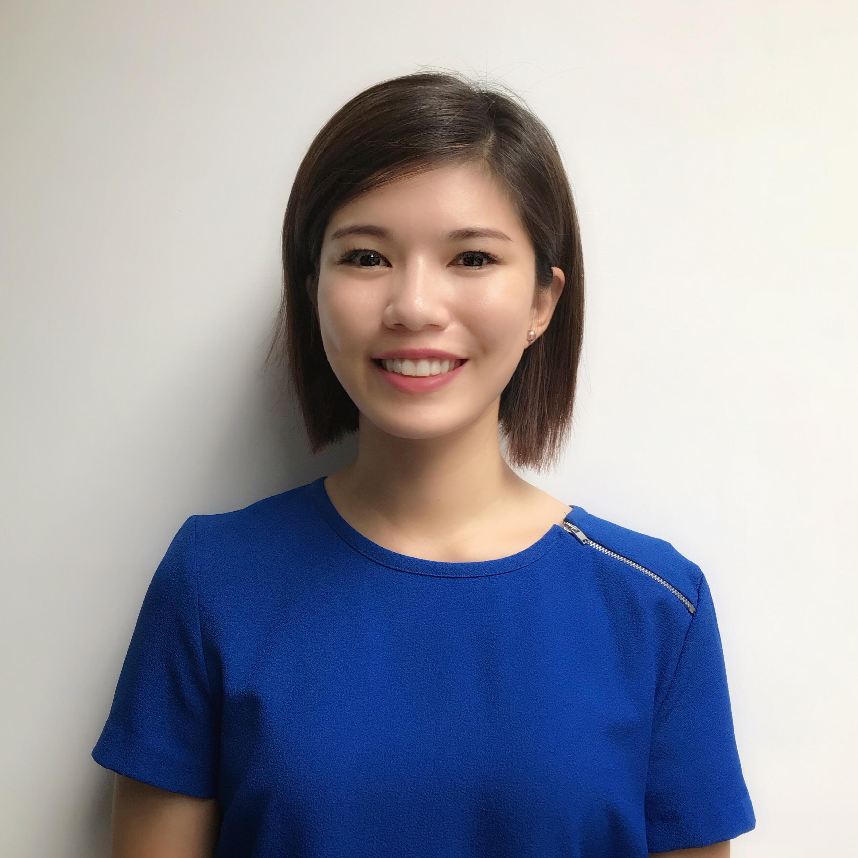
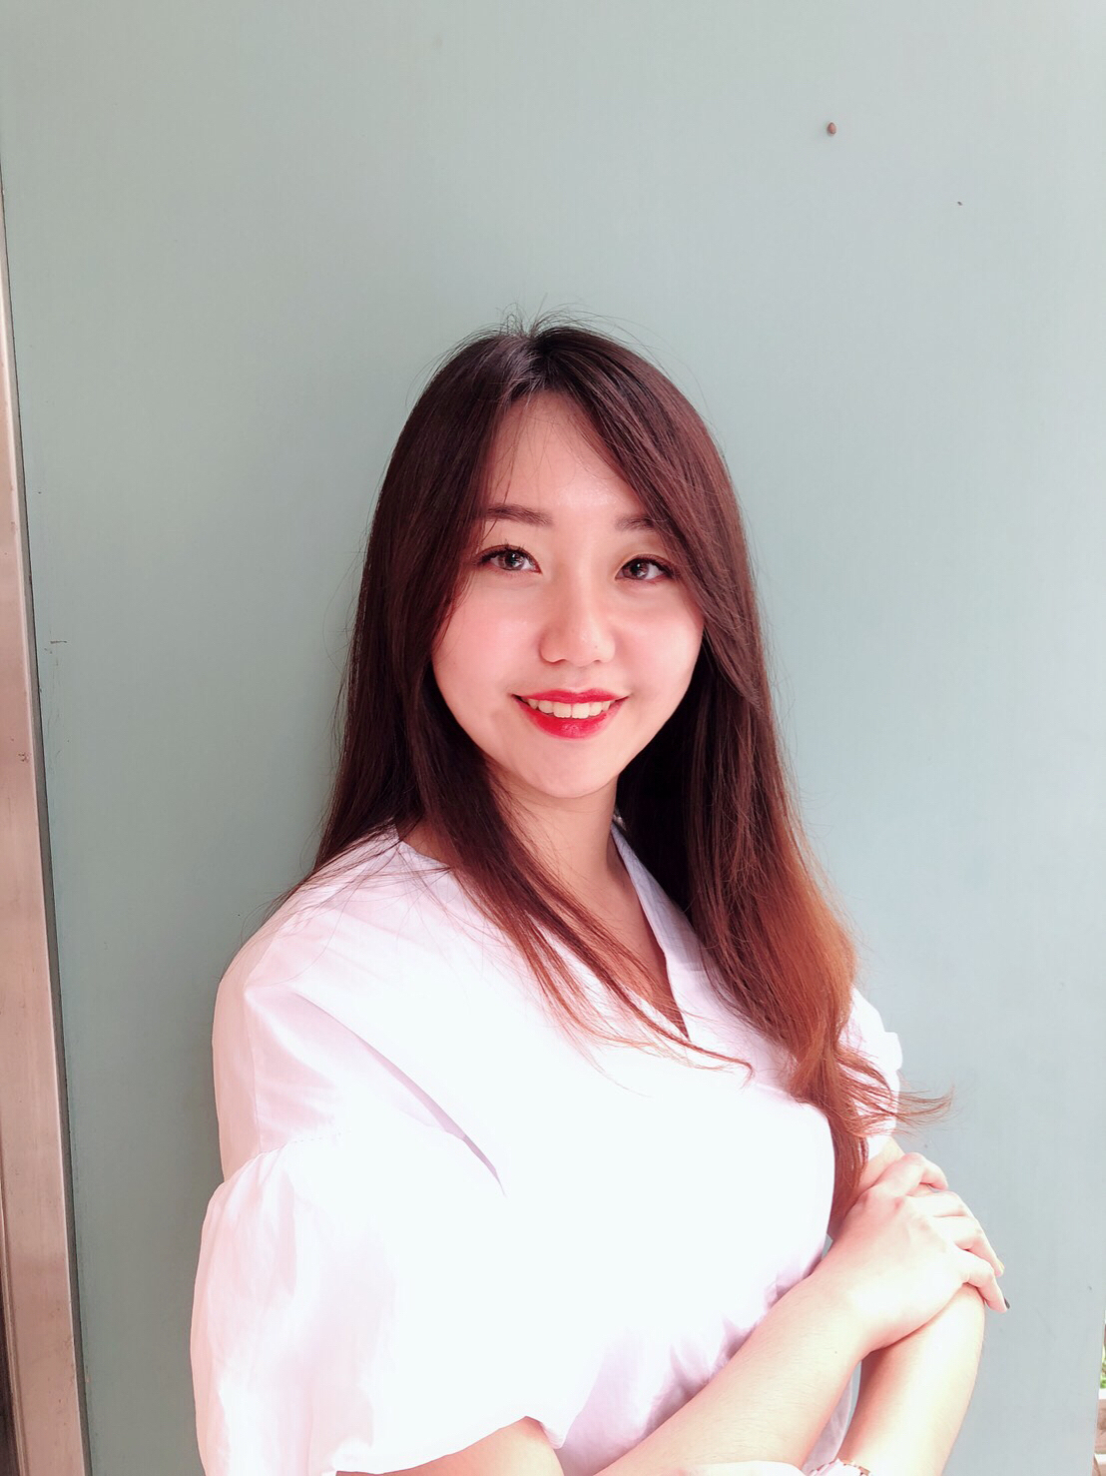
團隊名單
職稱 | 中文 | 英文 |  | LinkedIn | 簡介
CEO | 王絢臻 | Michelle Wang |  | https://www.linkedin.com/in/michelle-wang-80138b170/
Co-Founder | / | Phil Scotti |  | https://www.linkedin.com/in/phil-scotti-0579ab2a/
Co-Founder |  | Simone Sansavini |  | https://www.linkedin.com/in/simonesansavini/
Co-Founder | / | Wadi Rahim |  | https://www.linkedin.com/in/wadi-rahim-28a589a9/
Consultant | 相子元 | Tzyy-Yuang Shiang |  | 需註冊
Consultant | / | Matteo Stefanini |  | https://www.linkedin.com/in/matteo-stefanini-2340318b/
CTO | 張照國 | Aeron Chang |  | https://www.linkedin.com/in/aeron-chang-65b48b38/
PM | 吳橞潣 | Jackie Wu |  | https://www.linkedin.com/in/jackiewu07/
Community Manager/ Speaker | 張庭慈 | Sophia Chang |  | https://www.linkedin.com/in/sophia-chang-528128157/

Slide 3
王絢臻 Michelle Wang
Founder and Executive Director at Strength Master Group
Tunghai University, Executive Master of Business Administration (EMBA)
Aims to help people follow through their workout routines by integrating both hardware and software to provide an all inclusive solution to health and wellness.
明躍國際 創辦人與執行董事
東海大學高階經營管理碩士在職專班(EMBA)
台灣青年創業楷模第29屆相扶獎
以幫助人們有效落實持續性的運動為目標，提供全方位的健康解決方案，發展獨特的競爭優勢，朝向健康領域的領導者積極發展。

Slide 4
Phil Scotti
Strategic Consultant for various companies
Founder and CEO of Mindless Weight Loss LLC in 2016
Co-Founder of Body by Jake Global
25 years experience in the health and fitness business Phil has managed numerous marketing programs, sponsorships and partnerships with notable companies including Time Warner, Comcast, the NFL, Reebok, American Airlines, Disney, 24 Hour Fitness and Random House
現任多家公司資深策略顧問
Discovery Fit and Health聯合創始人兼製作人
Body by Jake Global 聯合創始人
擁有超過25年的健康和健身業務經驗，致力於建立一個健身帝國，並被美國評為在電視行業中最具有影響力的人物之一。經營過許多營銷計畫，包含與Time Warner, Comcast, the NFL, Reebok, American Airlines, Disney, 24 Hour Fitness and Random House

Slide 5
Simone Sansavini
Entrepreneur and expert in International Business Management
CEO of Italian Trade Centre and Change Training Retired rowing athelete. Italian national team from 1983 to 1987. Italian champion (boat 4 coxless) in 1985. Bronze medal in 1985 world championship. Many other results and medals in international competitions
專精於國際企業管理與銷售訓練
意大利對外貿易中心 國際貿易諮詢公司 CEO
退役的意大利國家代表隊賽艇選手。1983-1987年曾任義大利賽艇國家代表隊, 獲得許多國際賽事的好成績，1985年是意大利冠軍，同年也在世界錦標賽中為意大利奪得了銅牌

Slide 6

Wadi Rahim
Currently a consultant in the fitness industry
Entrepreneur and owner of several companies in military robotics, environmental remediation, small aircraft manufacturing, aircraft maintenance
MS Electrical Engineering, Virginia Polytechnic Institute and State University
Previously, Wadi served several senior engineering positions in major aerospace corporations, including Lockheed. He received the Robert E. Gross Award from the Lockheed Corporation for Technical Excellence and Significant Contributions to several major projects. He was also in multiple engineering positions in Fitness equipment manufacturing industry.
目前擔任專業顧問於健身產業
畢業於 美國維吉尼亞理工大學 主修電氣工程領域
同時兼任多間企業公司的創辦人及董事，涵蓋的範圍有軍事機器人、環境修復工程、小型飛機製造、飛機工程維修
曾任洛克希德 馬丁 (美國知名航太公司) 及多個航太公司擔任高級工程師，並在健身器材製造行業擔任多項工程職位獲得Robert E. Gross獎項之殊榮，以表彰在多個重大項目中的卓越技術和重大貢獻。

Slide 7
相子元Tzyy-Yuang Shiang
Distinguished Professor of College of Sports and Recreation in NTNU
Managing Director of Taiwan Sports Technology Association
Main Organizer of Chinese Taipei Asian Games Sports Science Team at the National Sports Training Center
Ph.D. - Mechanical Engineering (major in Biomechanics), Pennsylvania State University
Research specialist in Sports Equipment Design, Sports Biomechanics, Exercise & Sports Science, Bio Medical Engineering. Doctor T.Y. Shiang
現任
台灣師大 運動科學研究所 特聘教授
台灣運動科技發展協會 理事長
中華台北奧運亞運運科小組 總召集人
美國賓州大學機械專長的博士，曾榮獲科技部2016年傑出研究獎，在運動科技及運動產業研究上更是國內首屈一指的專家。
曾經在2006-2008年參與過NIKE公司在北京奧運執行的大型開發計畫，也與全球各國實驗室研發科技運動鞋、科技運動襪，在運動生物力學及運動科技前瞻議題上有相當豐富的研究及實務經驗

Slide 8
Matteo Stefanini
3 Times Italian Olympic Rowing Athlete
LUISS Business School MBA
意大利賽艇奧運選手
意大利LUISS商管學院MBA
在2005地中海賽艇獲得金牌，2013年歐洲錦標賽活得銀牌，2010年世界賽艇錦標賽獲得銅牌

Slide 9
張照國Aeron Chang
VP of New Business Dev. at Strength Master Group
+13 years of fitness system integration experience. Focusing mainly in commercial grade equipment, building the infrastructure to support B2B and B2C environment.
明躍國際 新創處 副總
超過13年的運動器材整合經驗，專長於商用運動器材與新技術的整合開發，為B2B還有B2C的環境建立系統架構

Slide 10
吳橞潣Jackie Wu
Executive Assistant/ Marketing Manager at Strength Master Group Foster School of Business, University of Washington
Jackie has a strong passion in fitness and digital marketing. She used to work for Europe's No.1 company for Home Fitness in Germany. As a global-minded marketer, she continues her pursuit of international marketing in the fitness industry while making fitness a lifestyle.
明躍國際 總經理特助
西雅圖華盛頓大學企管系畢業 主攻行銷
熱愛健身，曾在德國任職於歐洲第一大家用健身器材公司，現仍在運動產業致力於國際行銷企劃，努力將運動融入生活的實踐家

Slide 11
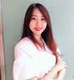
張庭慈 Sophia Chang
Bachelor of Life Sciences, National Tsing Hua University
Have great enthusiasm for sports, fitness and fashion.
Got into crypto-currencies since 2016, Sophia manages her own crypto-currency group, and has the title of " cryptocurrencies sweetheart.”
清華大學生命科學系畢業，對運動健身與愛美有極大的熱忱。
自2016年接觸加密貨幣，管理私人社群，有「幣圈甜心」的封號。

